Slide 1
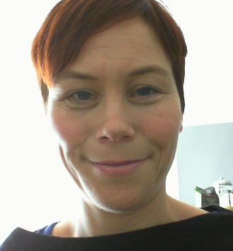
Have you had an operation for a broken hip?
Would you like to give advice to health researchers who want to improve surgery for people with a broken hip?
Are you: A patient with experience of surgery for a broken hip, or have you cared for someone after surgery for a broken hip?
Interested? We want to hear your thoughts on what we prioritise in our research, how we recruit people and what is important from your point of view. You do not need to know anything about research to take part. This is for anyone who has experience of having hip surgery for a broken hip, or caring for someone who had this kind of surgery.
Where? The meeting will be held at the University of Exeter Medical School, St Luke’s Campus, on Heavitree Road (opposite Waitrose)
When? Tuesday July 5th (10-12pm)
Contact: Kristin Liabo on k.liabo@exeter.ac.uk or call 01392 72 2895 to register or for more info
“I am a researcher at the University of Exeter Medical School. I work with patients and carers so we can do research relevant to them”

